Slide 2


Value proposition
1
IDENTIFICATION
How can I identify my customers/users in a safe way?
2
SIGNATURES
How can I digitize and streamline my document processes?

Slide 3










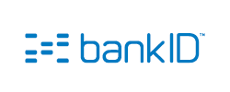


















Idfy at a glance
eID portfolio
Usecase
Idfy-case example
KYC/
customer onboarding
Real estate bidding
Identification of callers
Digital age control
Efficient sales process
Digital administrative processes
Products
Offices
Idfy offers user-friendly solutions for digitizing and streamlining costly manual document processes and has large and small customers in over 20 different industries. We work with everything from large established banks and festivals to small accounting offices and startups. Idfy has the last couple of years become a preferred supplier of secure identification and electronic signing to many small and large innovative companies, especially within the fintech industry. We also have integrations in different professional systems such as Uni Economy, SuperOffice and Infodoc. We have very flexible and developer-friendly REST APIs that are well documented.
API
Form
Portal
Integration
Bergen
Oslo

Slide 4

























Idfy has large and small innovative customers and a strong foothold within «fintech»
Banking, insurance, asset mangement & fintech
Innovative customers

Slide 5



Drivers behind usage of trust services
1
Efficiency
Between 2006 and 2013, ICT was stood for about 50 percent of the total productivity growth in Norway. The need to strengthen productivity in Norway has led to a sharp rise in the demand for digitization services. Digital signature and identification solutions provide immediate benefits to the businesses that use them.
2
Regulation
At European level, there are now several regulations in force or in preparation that affect the use and demand for electronic IDs (PSD2, eIDAS, GDPR, AML4). All of these regulations point to the fact that digital trust services are crucial for further growth in the digital economy.
3
Security
Preventing fraud and safeguarding privacy and security are becoming increasingly important as criminals become more sophisticated in the methods they use. Digital solutions for identification and signature are becoming increasingly important as the consequences of security breaches become more and more severe.

Slide 6

The essence of PSD2 is authentication and APIs
“If the practical application of the PSD2 is to be really effective and transform the digital payments market in Europe, the real challenge will be to come up with standards for the bank API sector in terms of definition, nomenclature, access protocols and authentication (OAuth, certificates, tokens, two-factor authentication etc.) – this last under the umbrella of XS2A – focused on access to bank account information.”
https://bbvaopen4u.com/en/actualidad/psd2-and-open-apis-banking-start-exponential-era-fintech-and-online-payments

Slide 7
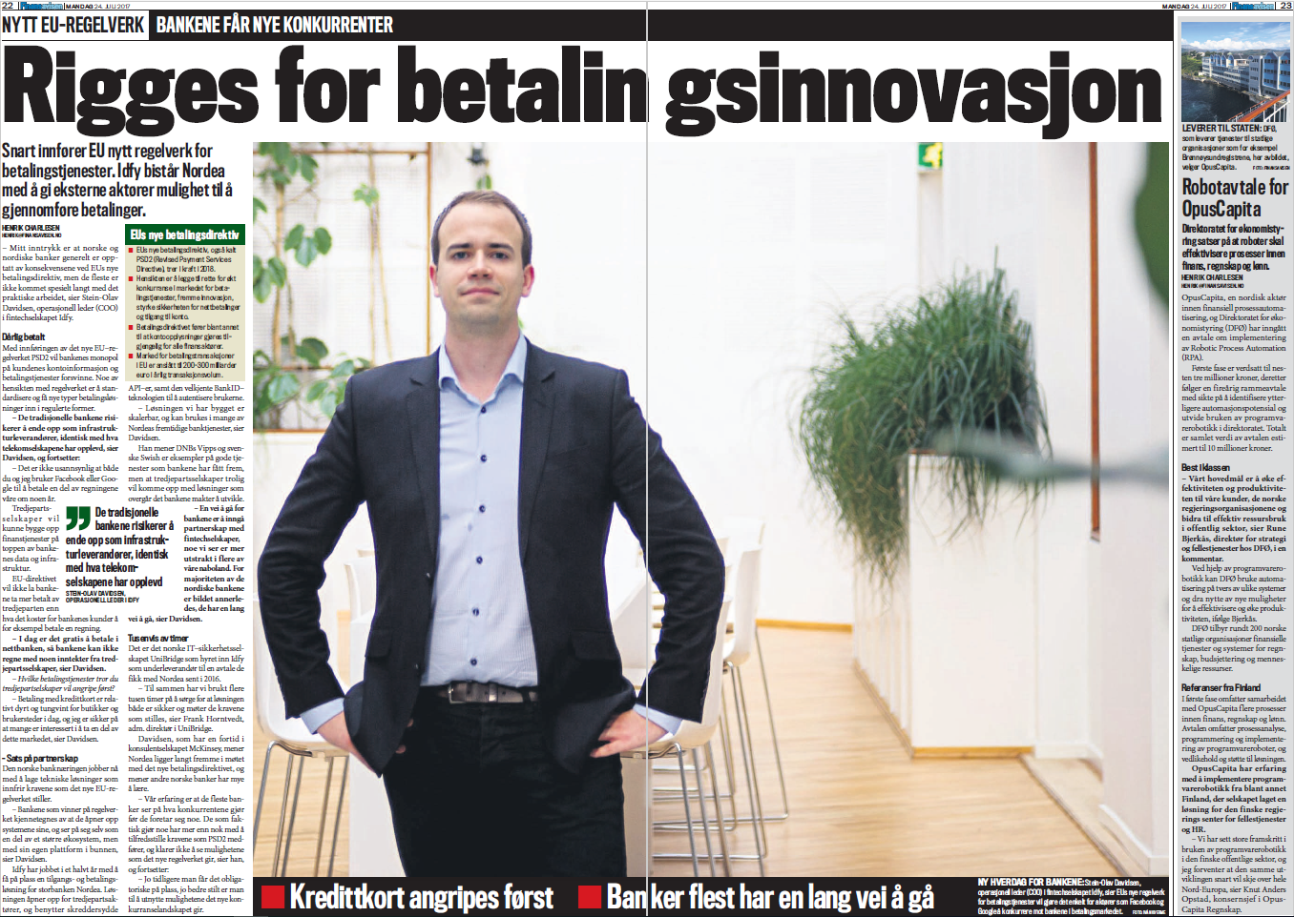
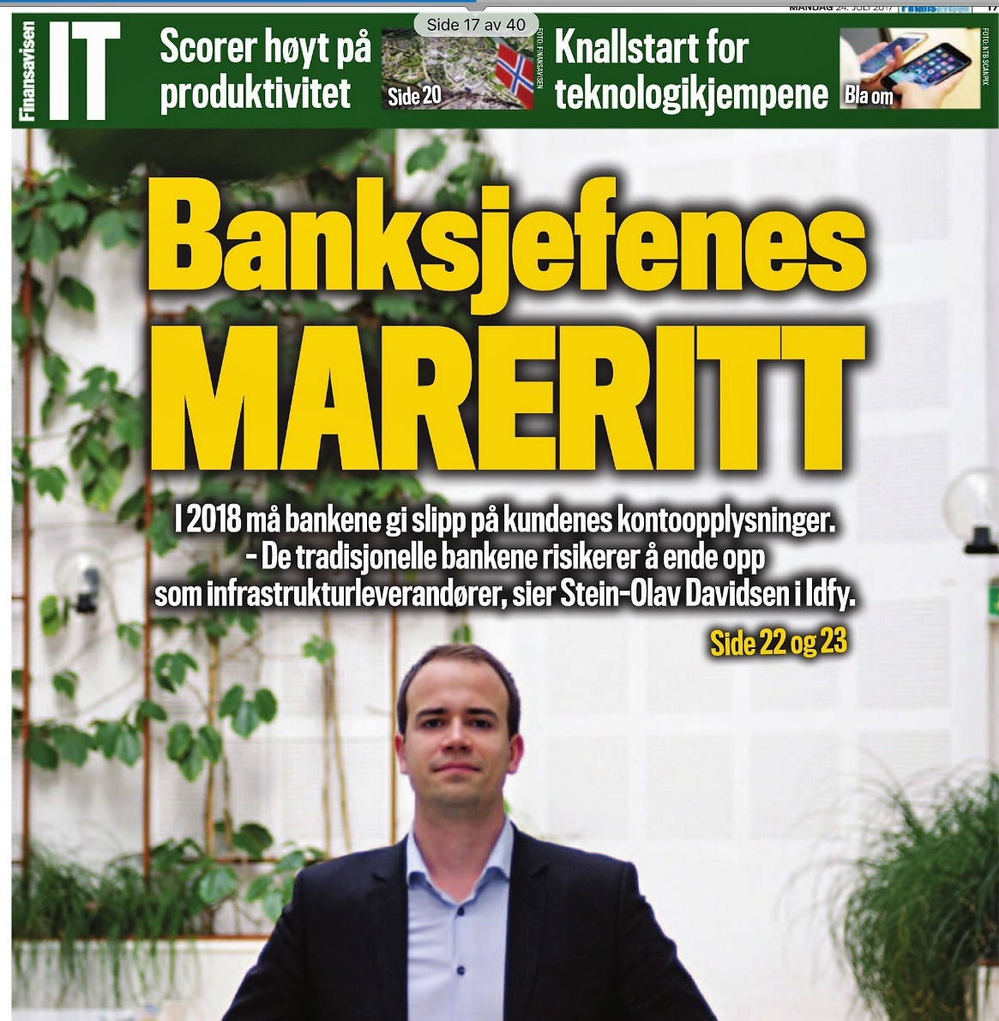
Idfy built the first «Access to Account» (XS2A) payment solution in Norway
Interview with Idfy COO Stein-Olav Davidsen about PSD2 in «The Norwegian Financial Daily» (Finansavisen) 22.07.2017

Slide 8

“If developers are the new rock stars, APIs are their instruments”

Slide 9
































Idfy APIs as platform for developers who need to build processes for identification, signing and other types of trust services across countries, use cases and security levels
Video/
biometics
Information services
Portfolio of trust services
Idfy IDENTIFY
Idfy SIGN
Idfy SEAL
Idfy AUDIT
Idfy TIMESTAMP
Idfy PAY
Idfy KYC/AML
Etc.
PKI
Developers
Mobile
ID and signature mechanisms
«Scribble»
ID management and security platforms
Social

Slide 10






BULDING BLOCKS FOR DEVELOPERS
COMPUTE & STORAGE
MAPS
COMMUNICATIONS
ANALYTICS
PAYMENTS
IDENTITY

Slide 11

What are we doing to help you as a developer?
-> What’s in it for you?

Slide 12

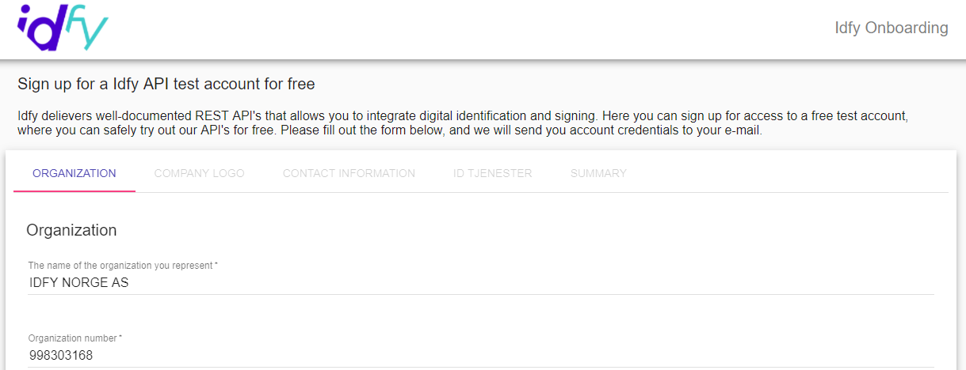

We believe in self service
Do you want to set up a meeting with sales in order to get things done?...
...or would you like to set up accounts, subscriptions etc. yourself?

Slide 13
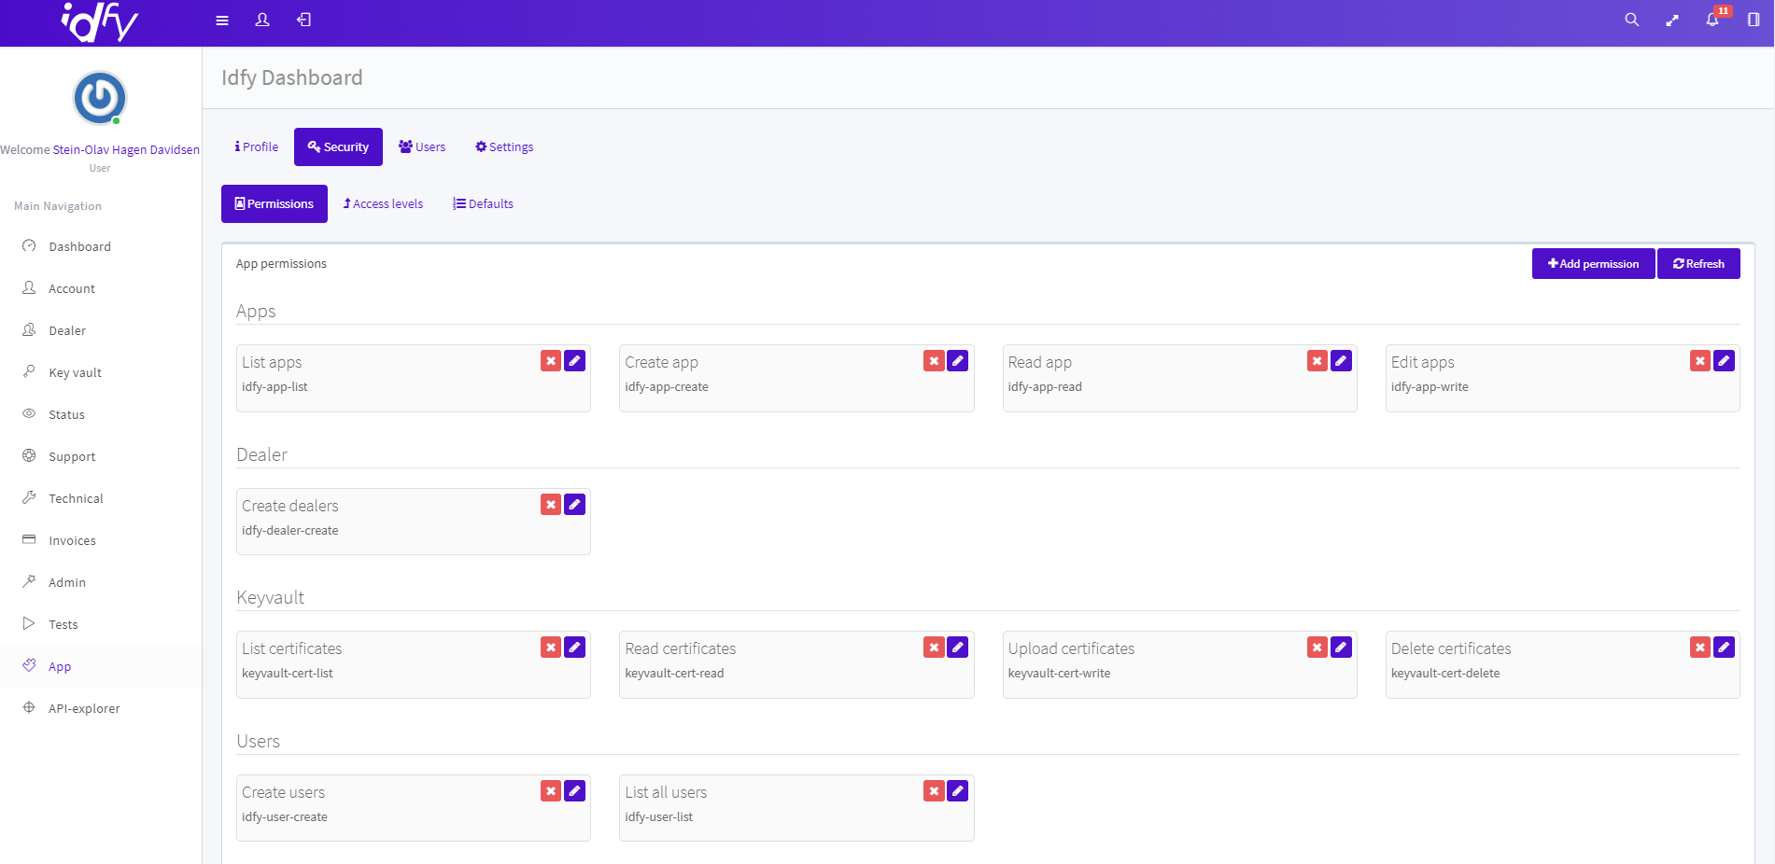
We are soon launching a developer dashboard, where you can get full overview and manage your API requests, OAuth clients, services etc.

Slide 14
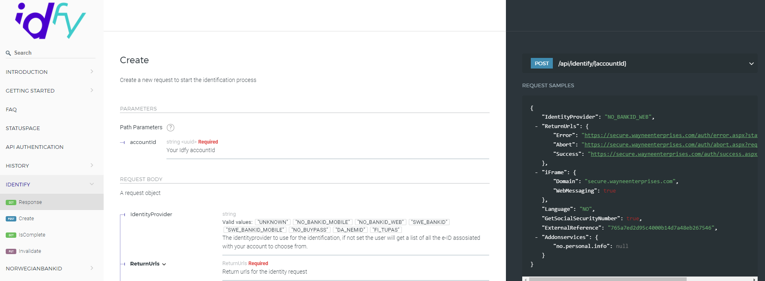
All APIs and services we build are REST based, and follow the OAuth2 authentication and authorization protocol

Slide 15
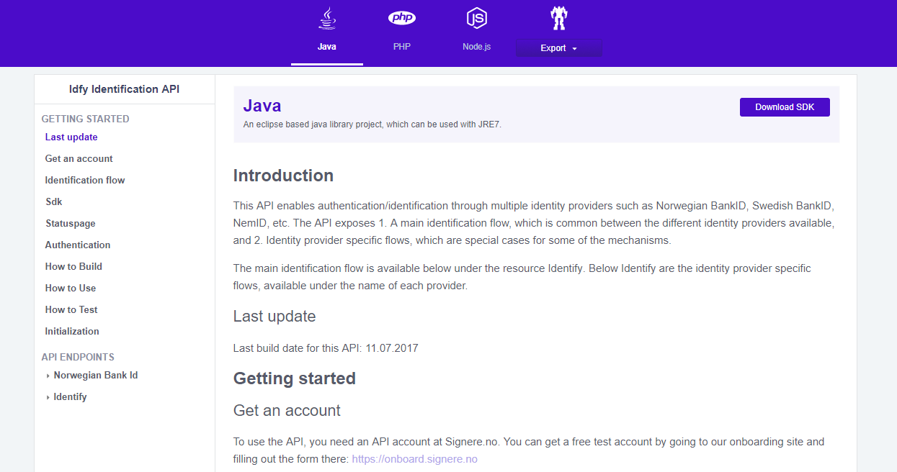
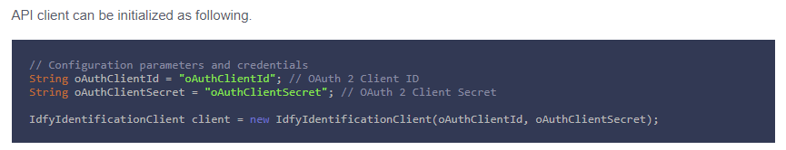
We provide SDKs in different languages, that also handle the API authentication/authorization part for you
Languages available on our portal today:
C# (.NET)
Java
PHP
NodeJS
Languages that can be added upon request:
Python
Ruby
Go
Objective C
Android (Gradle for Gingerbread and above)

Slide 16
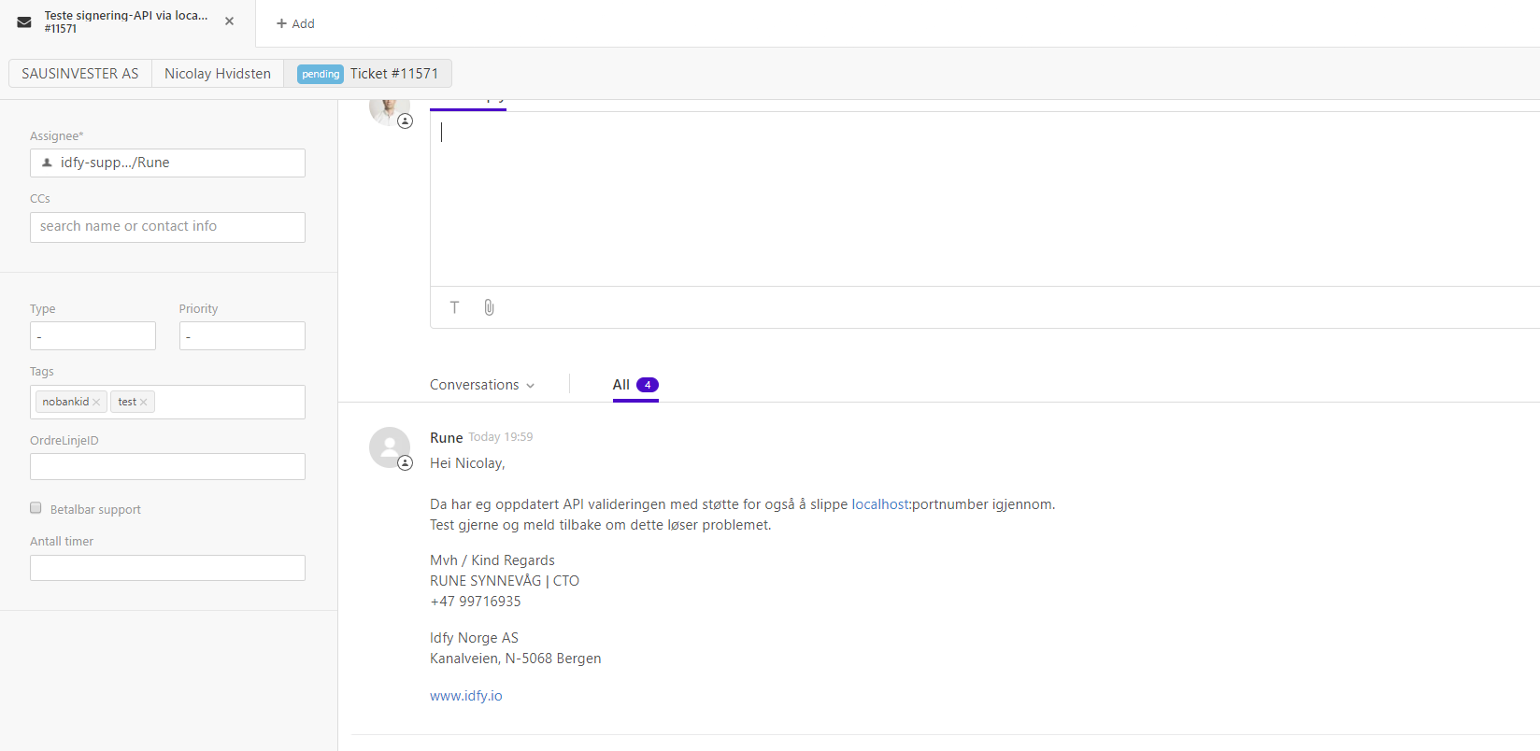
If you need assistance/guidance and best practice tips during integration, our developers are never far away

Slide 17
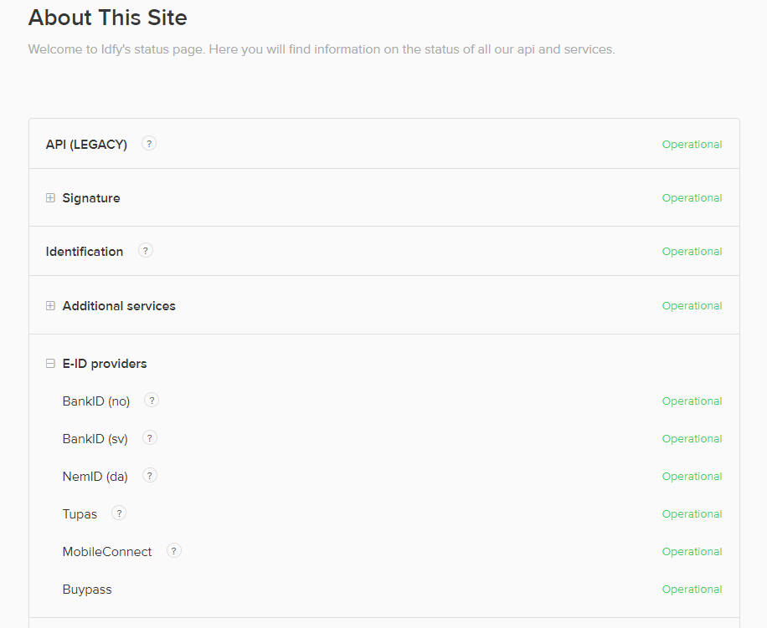
We also take care of monitoring the relevant infrastructures for you, so that you don’t have to worry
On our status pages, we have gathered statuses not only for our own services, but also for the infrastructures like BankID and so on
For the services that have status APIs, the statuses are relayed, whereas for others we have scrapers on manual status pages
Planned maintenance and other operational messages that are reported from us and external parties, are also relayed in our status service
Developers can subscribe to status updates on a mailing list

Slide 18

Oslo
Sven Samdal
Business Developer sven@idfy.io
+47 97656494
Visiting address:
Drammensveien 167, N-0277 Oslo
Bergen
Frank Lillebuen
Head of Sales frank@idfy.io
+47 48486292
Visiting address:
Kanalveien 109, N-5068 Bergen

